Slide 1


Traffic Sign Detection using YOLO and CNN
By
Niharika Bandekar-(22106136)
Sudhiksha Aradhyula-(22106010)
Aabha Bhide-(22106093)
Aditi Gadhave-(22106079)
Project guide
Prof. Poonam Tiware

Slide 2

Outline
Introduction
Problem Statement
Literature Survey of the Existing Systems
Technologies and Algorithms used
Objectives
Goals
Limitations of the Existing Systems
Block Diagram and Workflow
Implementation
Conclusion
References

Slide 3
Introduction:
Project focuses on Traffic Sign Detection and Classification using YOLOv8 for object detection and VGG16 for classification.
The system accurately identifies traffic signs from images, classifies them into predefined categories, and provides relevant information to enhance road safety

Slide 4
Objectives:
Accurate Traffic Sign Detection – Implement YOLOv8 to detect traffic signs in real-world images with high precision.
Efficient Classification – Utilize a VGG16-based model to classify detected signs into predefined categories.
Enhanced Road Safety – Provide clear identification of traffic signs to assist drivers and autonomous vehicles.
Real-time Processing – Ensure quick and efficient detection and classification for real-time applications.

Slide 5
Goals:
Develop a High-Performance Recognition System: Build a system that can detect and classify traffic signs with an accuracy exceeding 98% for practical and reliable use in autonomous driving.
Ensure Real-Time Functionality: Achieve real-time processing speeds to meet the demands of autonomous driving systems, ensuring seamless integration with existing technologies.
Handle Challenging Conditions: Create a robust system capable of operating effectively under varying weather, lighting conditions, and other real-world challenges, such as occluded or damaged signs.
Integrate Advanced Techniques: Leverage state-of-the-art methods like CNN-based feature extraction, YOLOv8 for detection.

Slide 6
Literature Survey :
:
PAPER NAME | AUTHOR | YEAR | DESCRIPTION
Acoustic Scene Classification using Spatial Pyramid Pooling with CNNs | Basbug AM, Sert M | 2019 | Discusses the use of spatial pyramid pooling with CNNs for acoustic scene classification.
Traffic Sign Classification using Deep Inception-based CNNs | M. Haloi | 2015 | Explores the use of deep inception-based CNNs for classifying traffic signs.

Slide 7
Literature Survey :
PAPER NAME | AUTHOR | YEAR | DESCRIPTION
YOLOv4: Optimal Speed and Accuracy of Object Detection | Bochkovskiy A, Wang C-Y, Mark Liao H-Y. | 2020 | Introduces YOLOv4, an improved version of YOLO for real-time object detection with optimized speed and accuracy.
Attribute-controlled Traffic Data Augmentation using Conditional Generative Models | A.Mukherjee, A. Joshi, S. Sarkar, C. Hegde. | 2019 | Proposes a method using conditional generative models for augmenting traffic data under various conditions.
:

Slide 8
Limitations:
Difficulty in Low Visibility: Performance may drop in fog, rain, or poor lighting conditions.
Occlusion Issues: Partially blocked or damaged signs may not be detected accurately.
Dataset Dependency: Accuracy depends on the quality and diversity of the training dataset.
Real-Time Processing: High computational power is needed for smooth real-time detection.
Variation in Traffic Signs: Different countries have different traffic signs, requiring model retraining.

Slide 9
Problem Statement:
The goal of this project is to develop a system that can automatically detect
and classify traffic signs in real-time using computer vision techniques.
The system will use YOLO (You Only Look Once) for detecting the traffic signs in images or video feeds and CNN (Convolutional Neural Networks) for classifying the detected signs into categories (such as stop, yield, speed limit, etc.). This technology is essential for enhancing the safety and reliability of autonomous driving and driver assistance systems by ensuring that vehicles can recognize and respond to traffic signs accurately and promptly.

Slide 10
BLOCK DIAGRAM

Slide 11
Real-Time Demo Application (Traffic Sign Detection & Classification)
YOLOv8-based Traffic Sign Detection
Detected Traffic Sign Regions
VGG16 Embedding
Extraction & Classifier
Traffic Sign Result
Final Output Display (Results)

Slide 12
Workflow of the System:
Input Video / Image → Frame Extraction
2.YOLO Model → Detects Traffic Signs
3.Detected Regions → Passed to CNN Model
4.CNN Classifies the Sign → Outputs Label
5.Final Results Displayed and Sign Classified

Slide 13
Algorithms Used:
1. YOLO (You Only Look Once) - Object Detection
Purpose: Detects traffic signs in images by drawing bounding boxes around them.
How it works:
The trained YOLOv8 model processes the input image in a single forward pass.
It predicts bounding boxes, class labels, and confidence scores.
The output includes the detected traffic signs along with their locations.
2. CNN (VGG16) - Traffic Sign Classification
Purpose: Classifies the detected traffic signs into predefined categories.
How it works:
The cropped image of the detected sign is resized and preprocessed.
The VGG16 model extracts deep features and classifies the sign.
The predicted class label is displayed along with confidence scores.

Slide 14
Integration in the Project
1.YOLO first detects traffic signs in an image and extracts the sign regions.
2.Each detected sign is passed to the CNN model (VGG16) for classification.
3.The final output consists of bounding boxes with labels and confidence scores displayed on the image

Slide 15
Technologies used:
Deep Learning Frameworks
TensorFlow (For CNN-based classification using VGG16)
Object Detection Model
YOLOv8 (You Only Look Once) – Used for detecting traffic signs in real-time.
Image Classification Model
VGG16 CNN Model – Used to classify detected traffic signs into specific categories.
Computer Vision Libraries
OpenCV – For image processing (resizing, cropping, preprocessing).
Pillow (PIL) – For handling image files.
Streamlit
Used to create a user-friendly web interface for uploading images and viewing results.

Slide 16
Details of the Database:
Dataset for CNN:
Dataset Type: Image dataset of traffic signs for classification.
Classes: 9 categories of traffic signs (Speed Limit, Stop, Yield, etc.).
Image Preprocessing:
Resized to 112×112 (to match VGG16 input size).
Normalized pixel values (0-1 range) for better model training.
Data Splitting:
Training Set (for model learning).
Validation Set (for evaluating model performance)
Dataset for YOLO:
Dataset Type: Image dataset of traffic signs for classification.
Classes: 9 categories of traffic signs (Speed Limit, Stop, Yield, etc.).
Preprocessing:
Images resized to 640×640 (to match YOLO input requirements).
Bounding boxes normalized (scaled between 0 and 1).
Data Splitting:
Training Set
Validation Set
.

Slide 17

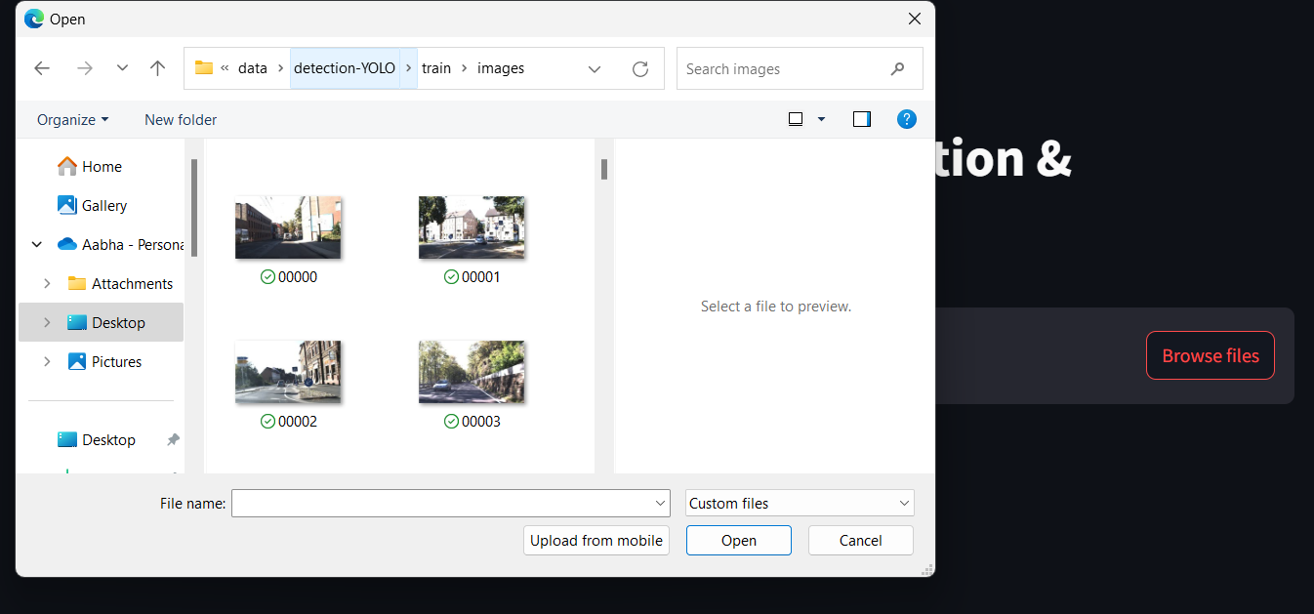
Implementation (input)

Slide 18
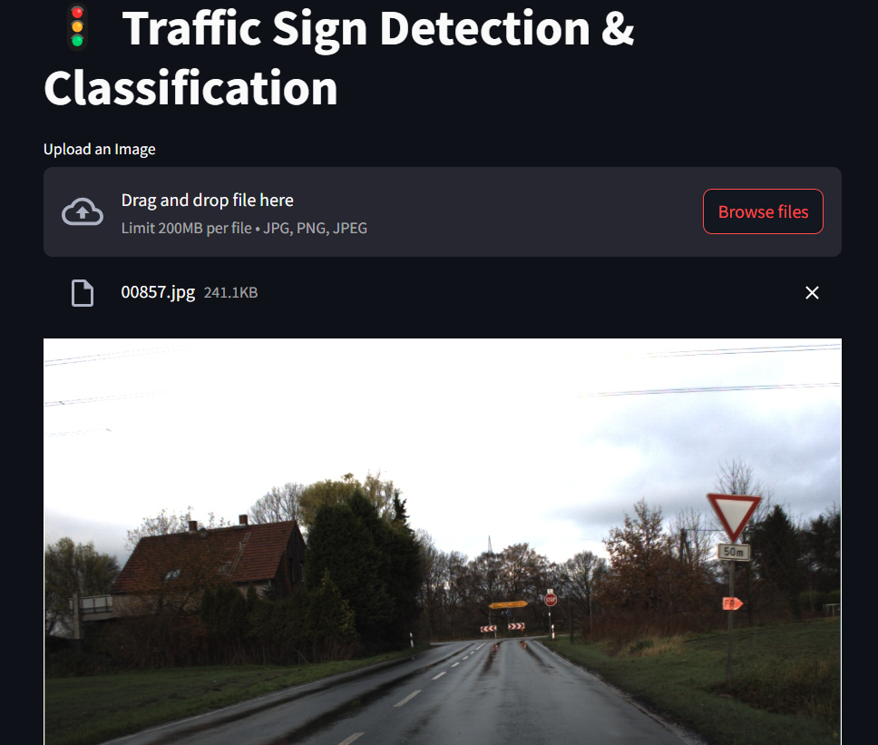
Implementation :
After giving input:

Slide 19
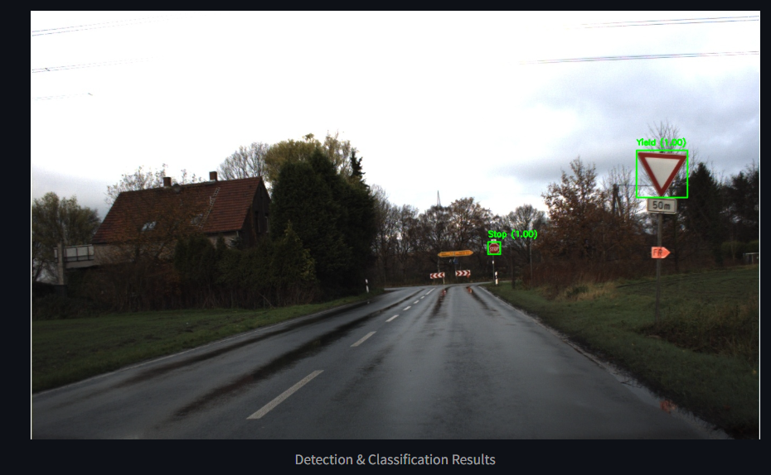
Implementation :
Output:

Slide 20
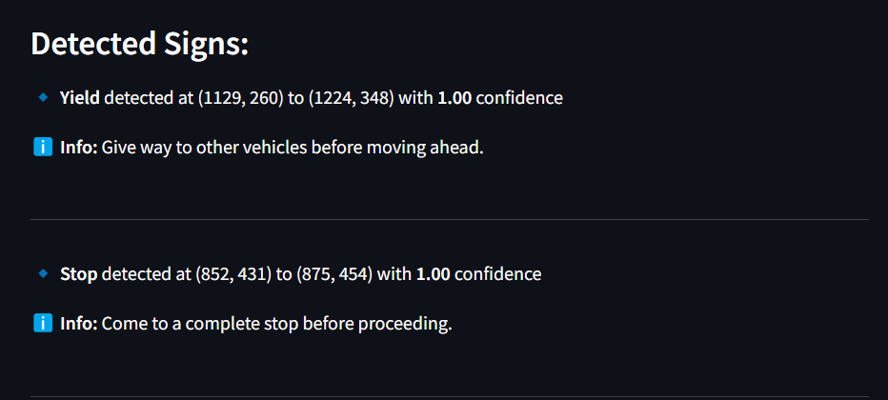
Implementation :
Output:

Slide 21
Conclusion:
The system successfully detects and classifies traffic signs in real-time using YOLOv8 and VGG16.
Achieves high accuracy and robustness, even under challenging conditions like poor lighting and weather variations.
Efficient feature extraction and classification improve recognition performance.
The system is scalable and adaptable for real-world autonomous driving applications.
Future improvements include video sequence analysis and handling occluded or damaged signs for enhanced reliability.

Slide 22
References:
[1] Basbug AM, Sert M (2019) Acoustic scene classification using spatial pyramid pooling with convolutional neural networks. In: proceedings - 13th IEEE international conference on semantic computing, ICSC 2019. Pp 128–131
[2] M. Haloi, "Traffic sign classification using deep inception based convolutional networks", CoRR, vol. abs/1511.0, pp. 1-5, 2015.
[3]Bochkovskiy A, Wang C-Y, Mark Liao H-Y (2020) YOLOv4: optimal speed and accuracy of object detection. arXiv:200410934 1–17
[4] A. Mukherjee, A. Joshi, S. Sarkar and C. Hegde, "Attribute-controlled traffic data augmentation using conditional generative models", Proc. CVPR Workshop Vis. All Seasons, pp. 83-87, 2019.
[5] W. Liu, D. Anguelov, D. Erhan, C. Szegedy, S. Reed, C.-Y. Fu, et al., "SSD: Single shot multibox detector", Proc. Eur. Conf. Comput. Vis., pp. 21-37, 2016

Slide 23
Thank You

